Slide 1
Grab Challenge
By: Yeo Sheen Hern (1902257)

Slide 2
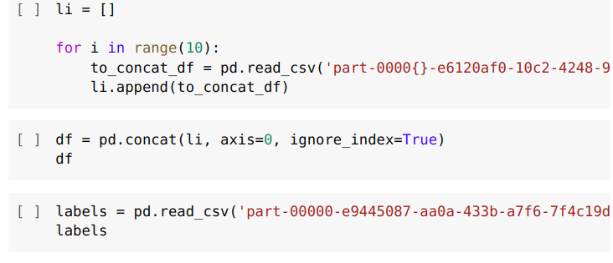
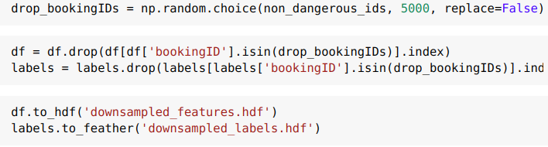
Data Preprocessing
Read the data
There are 15k non-dangerous trips and only 5k dangerous trips.
So we downsample the non-dangerous trips by dropping 5k of them.

Slide 3
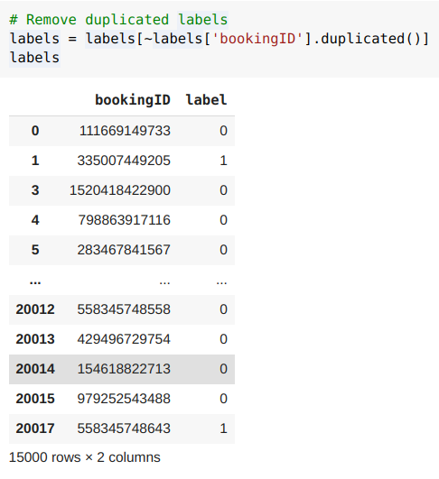
Data Preprocessing
Remove duplicate labels

Slide 4
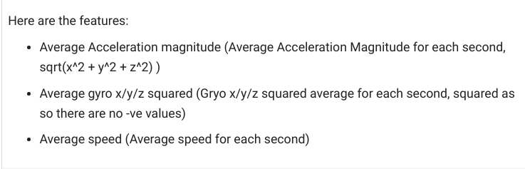
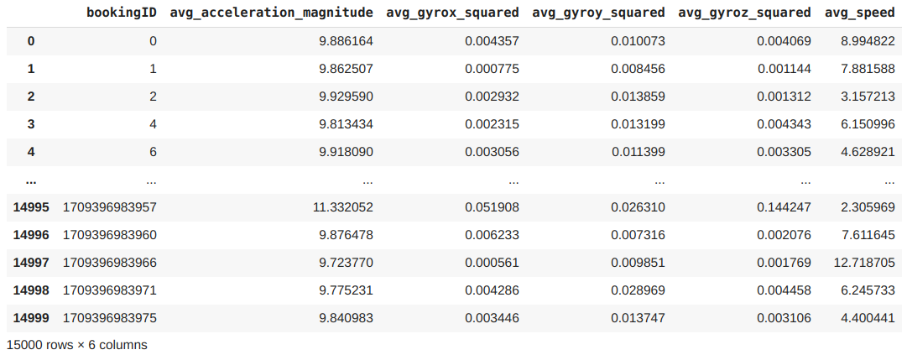
Feature Engineering
For this problem, we can aggregate the data for each bookingID, to create features for each trip, which can be used to predict the label.

Slide 5
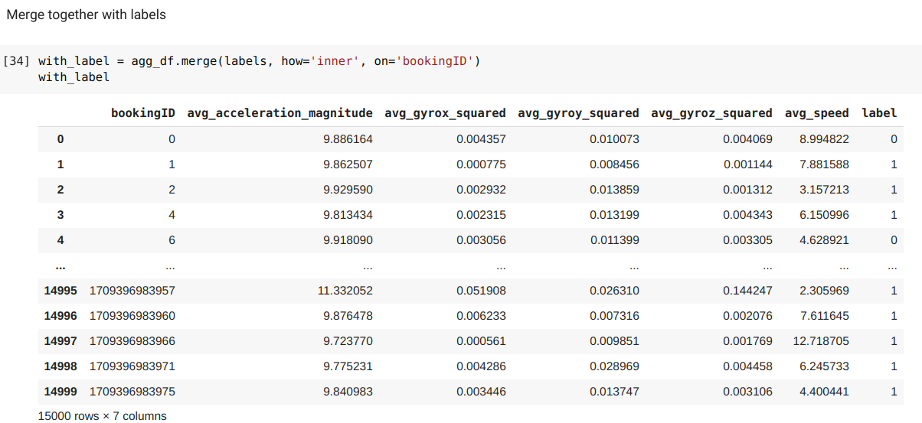
Feature Engineering

Slide 6
Feature Engineering

Slide 7

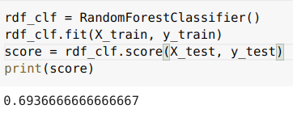
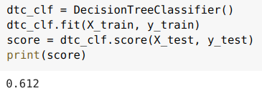
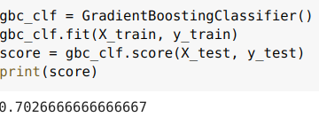
Model Training
XGBoost:
Random Forest:
Decision Tree:
Gradient Boosting:

